Slide 1

CSE3151
Computer Networks
(Session 2018-19)
Dr. Asif Zaman
Associate Professor, CSE, RU

Slide 2
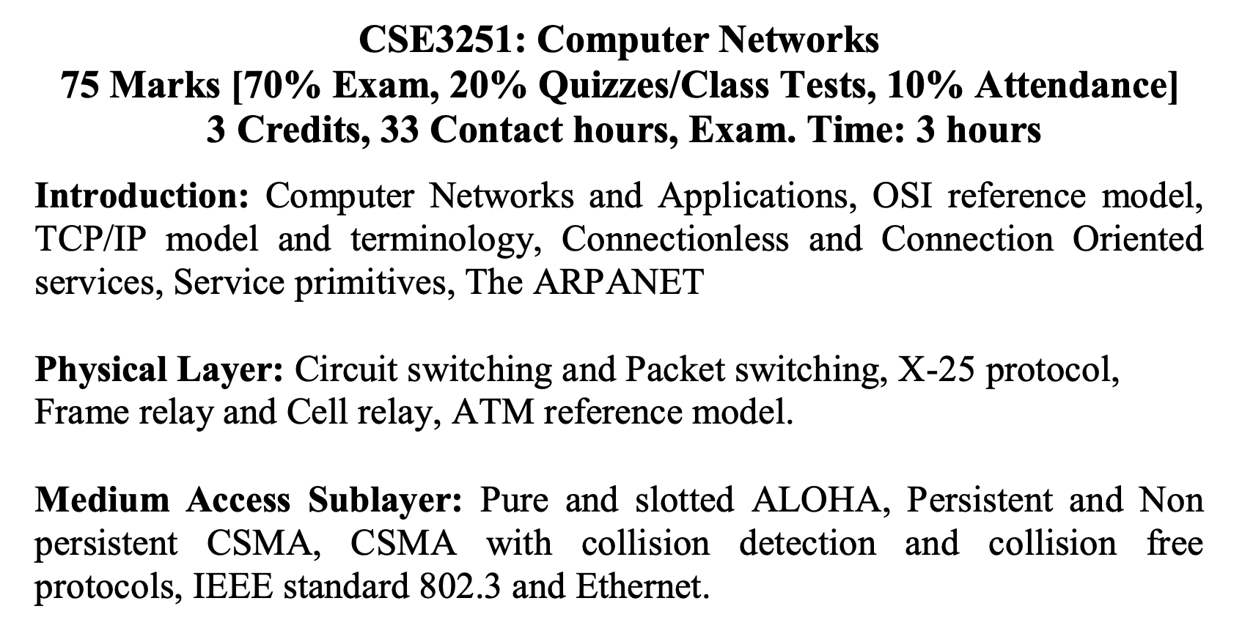
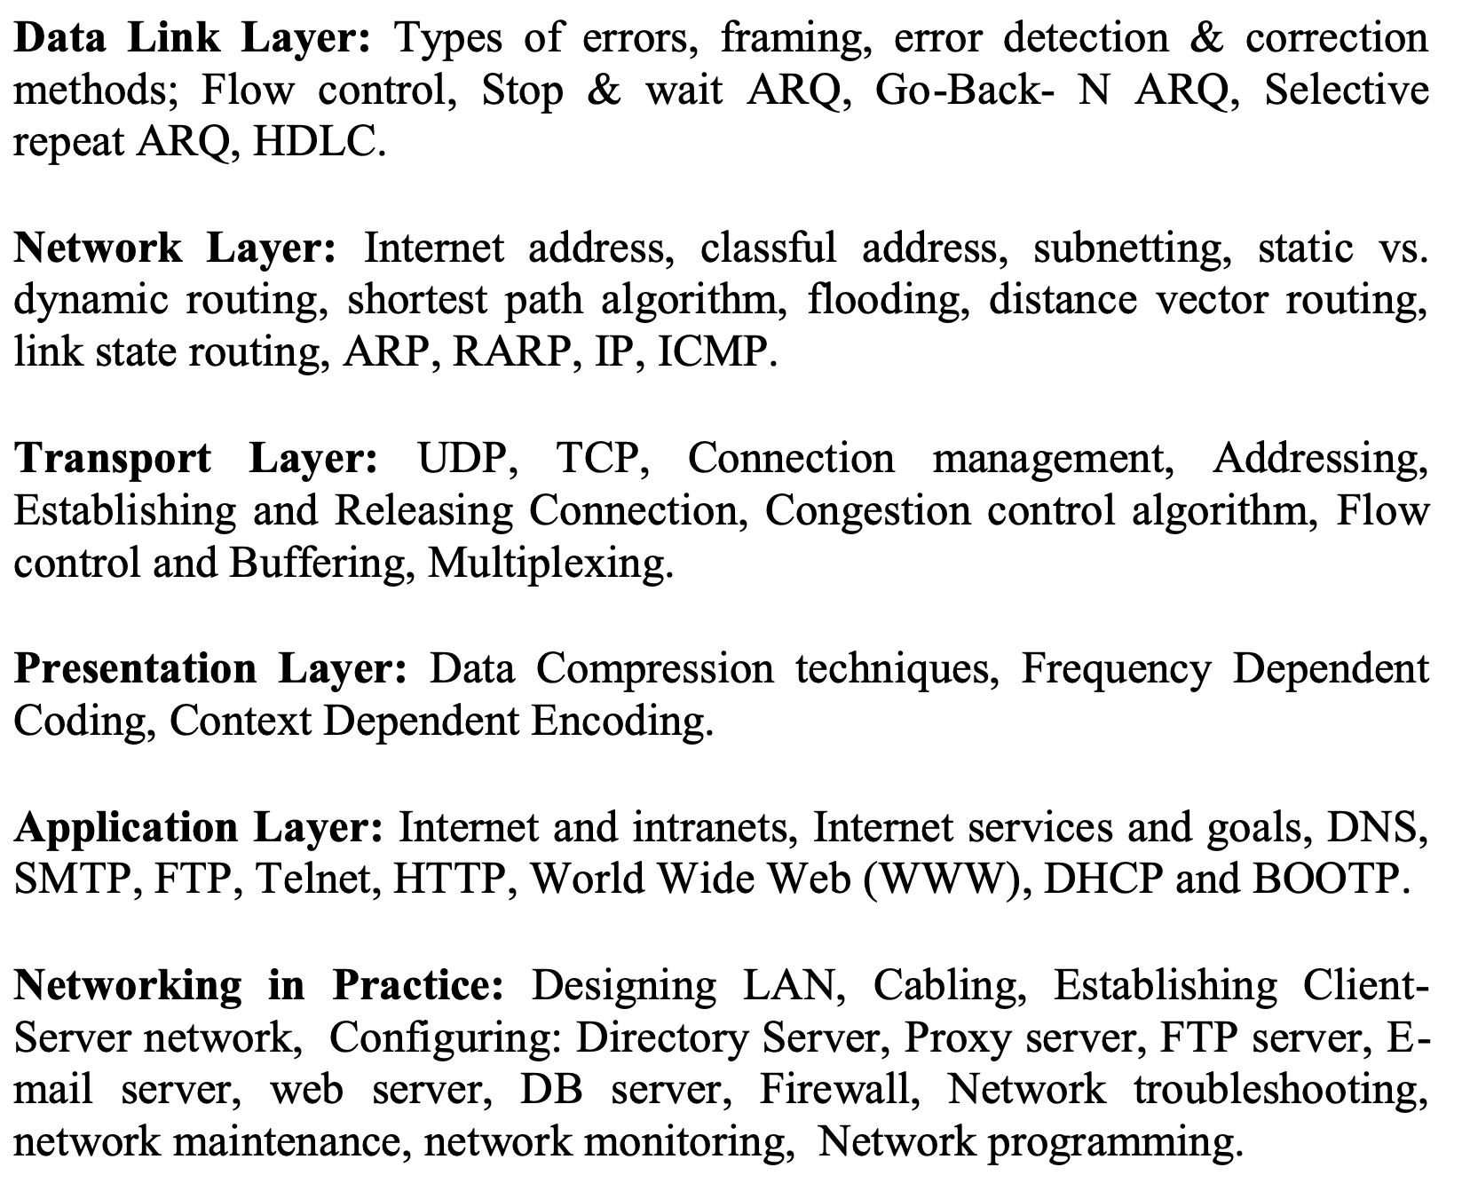

Slide 3
Switching
Switching ????
Switching is the practice of directing a signal or data element toward a particular hardware destination.
Two types:
Circuit switching
Packet Switching

Slide 4
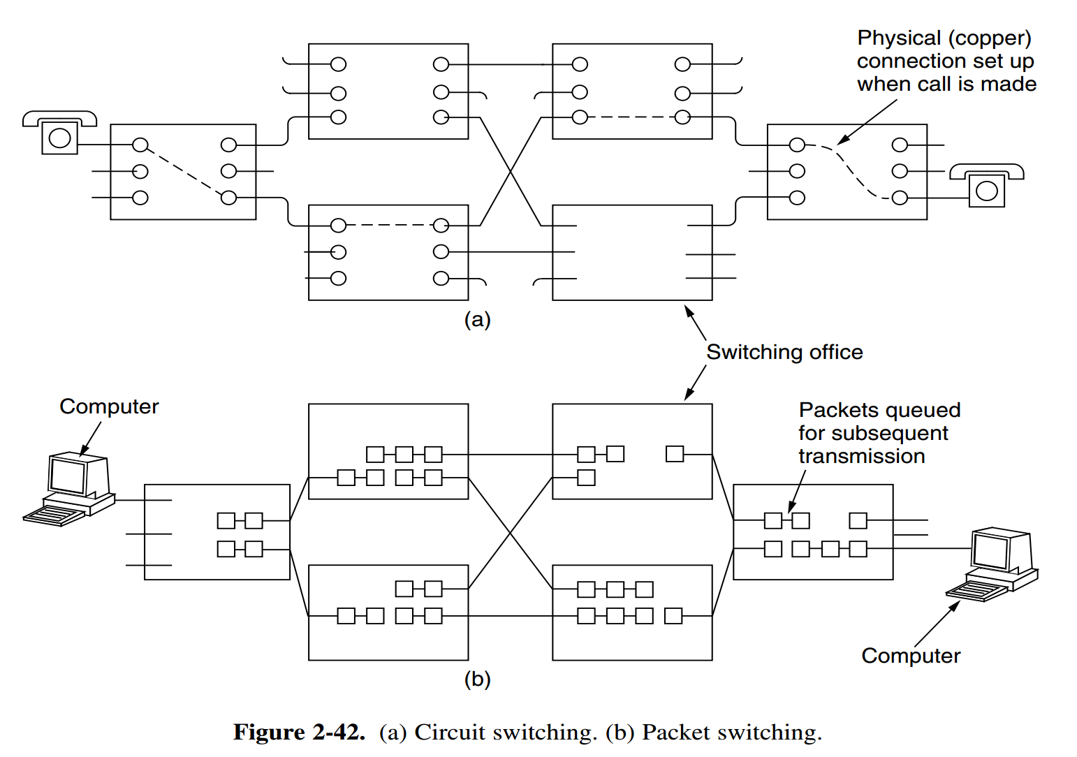
Switching

Slide 5
Switching
Switching Comparison
Circuit switching vs Packet Switching

Slide 6
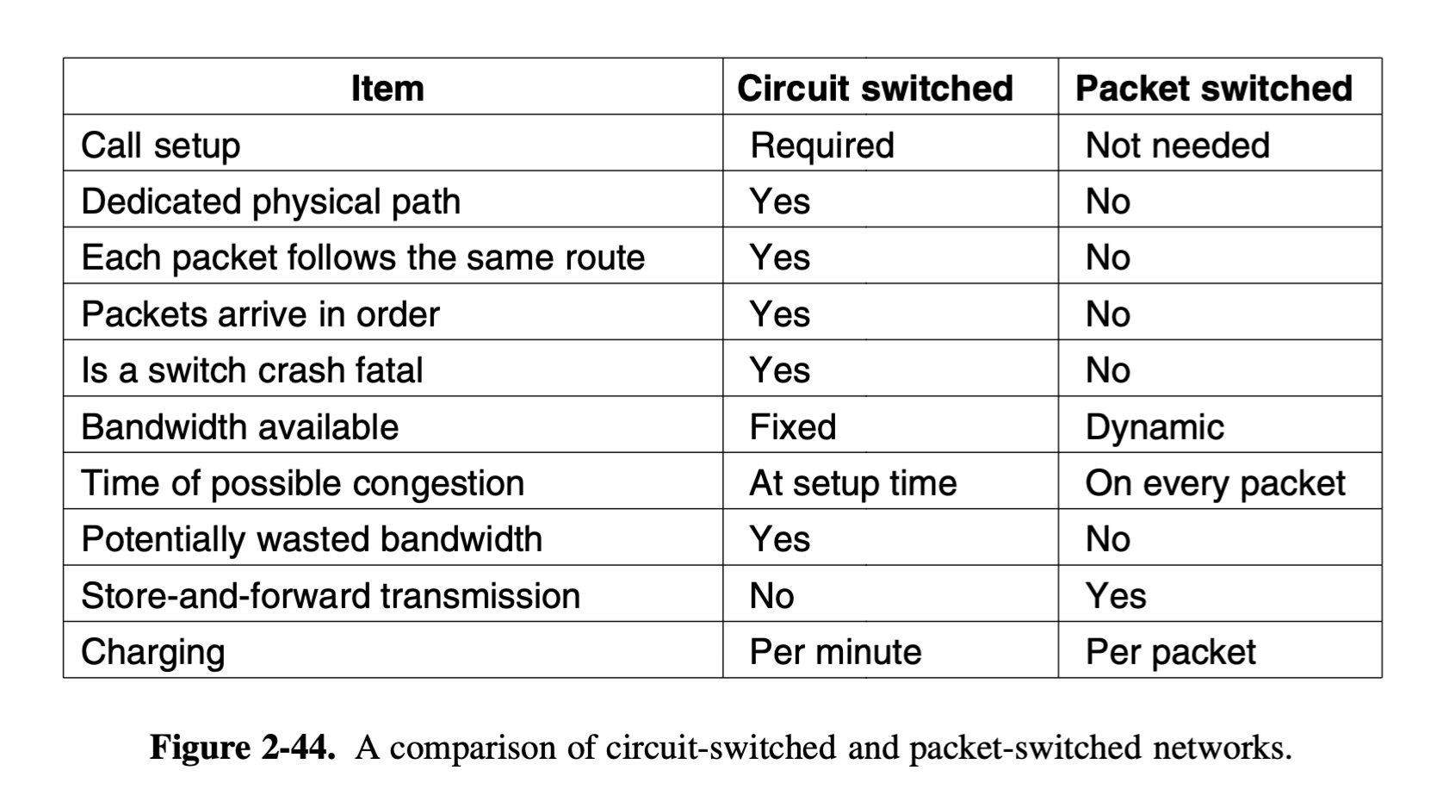
Switching

Slide 7
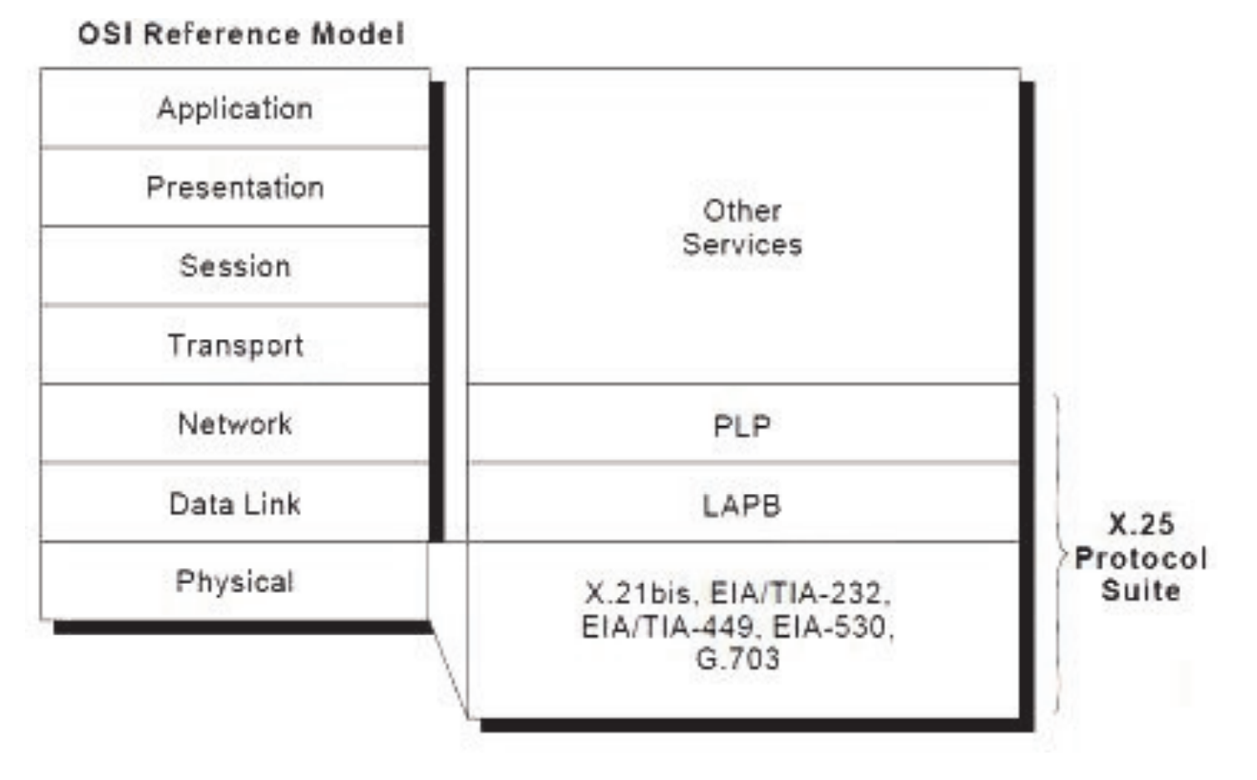
X.25 Protocol
… 1970s by ITU-T
ITU Telecommunication Standardization Sector (ITU-T)
ITU: International Telecommunication Union (ITU)
PLP: Packet Layer Protocol
LAP-B: Link Access Protocol - Balanced

Slide 8
X.25 Protocol
X.25 network devices … categories:
Data Terminal Equipment (DTE),
Data Circuit-terminating Equipment (DCE),
Packet-switching Exchange (PSE)
PAD- Packet Assembler/ Dissembler.

Slide 9
X.25 Protocol

Slide 10
DTE
Data terminal equipment devices are end systems that communicate across the X.25 network.
They are usually
Terminals,
personal computers, or network hosts,
and are located on the premises of individual subscribers.

Slide 11
DCE
DCE devices are communications devices, such as Modems and packet switches, that provide the interface between DTE devices and a PSE, and are generally located in the carrier's facilities.
PSEs are switches that compose the bulk of the carrier’s network.
They transfer data from one DTE device to another through the X.25 PSN.

Slide 12
PSE
PSEs are switches that compose the bulk of the carrier's network.
They transfer data from one DTE device to another through the X.25 PSN

Slide 13
Packet Assembler/Disassembler (PAD)
The packet assembler/disassembler (PAD) is a device commonly found in X.25 networks.
The PAD is located between a DTE device and a DCE device, and
it performs three primary functions:
Buffering (storing data until a device is ready to process it),
Packet assembly,
Packet disassembly.

Slide 14
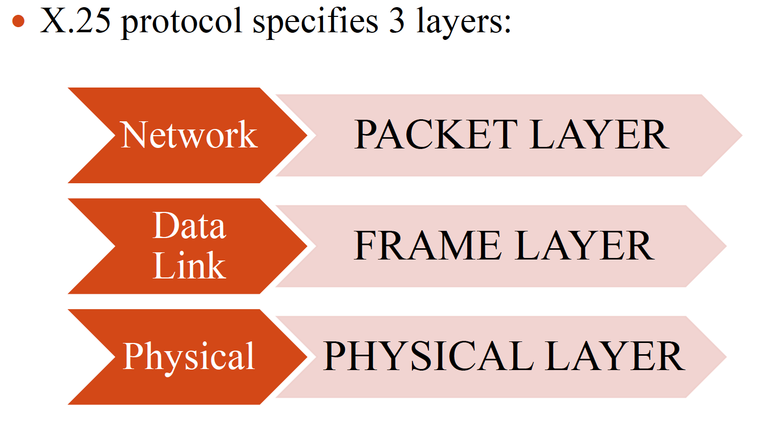
X.25 Protocol

Slide 15
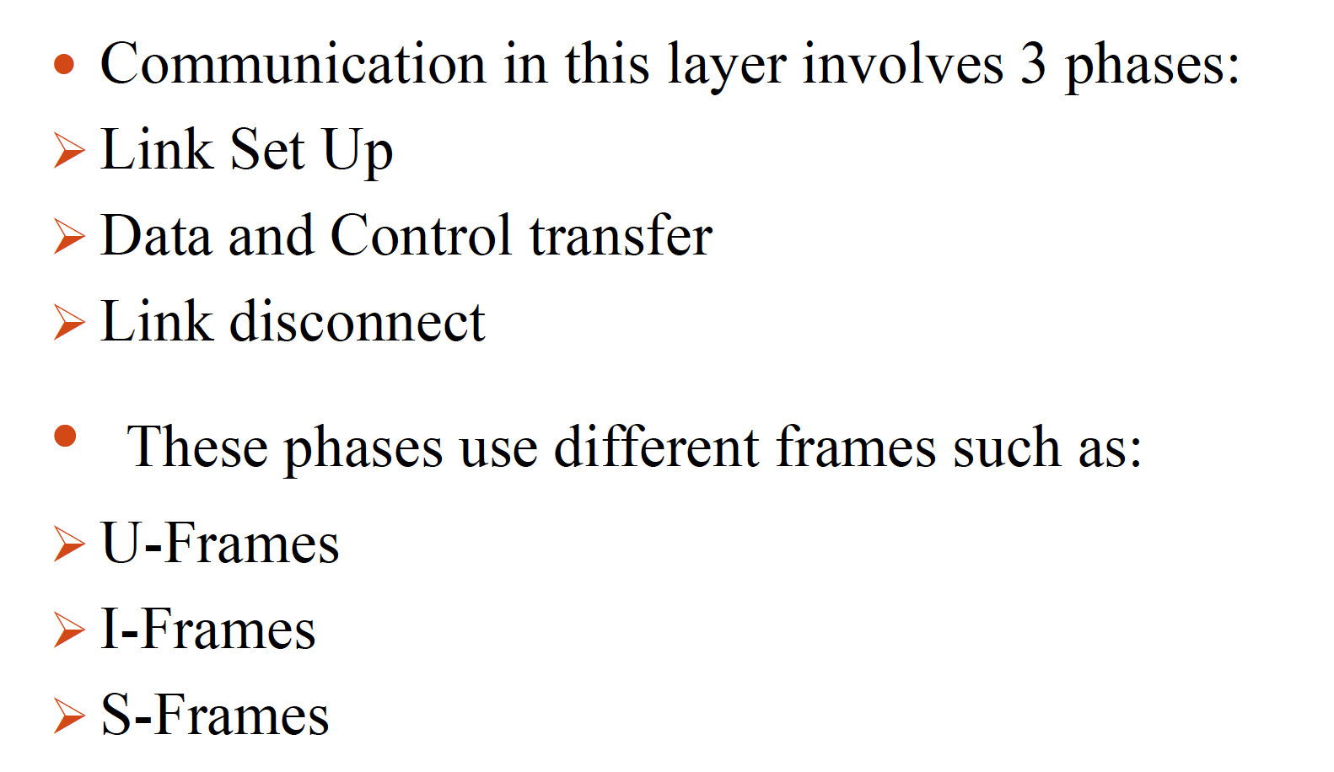
X.25 Protocol

Slide 16
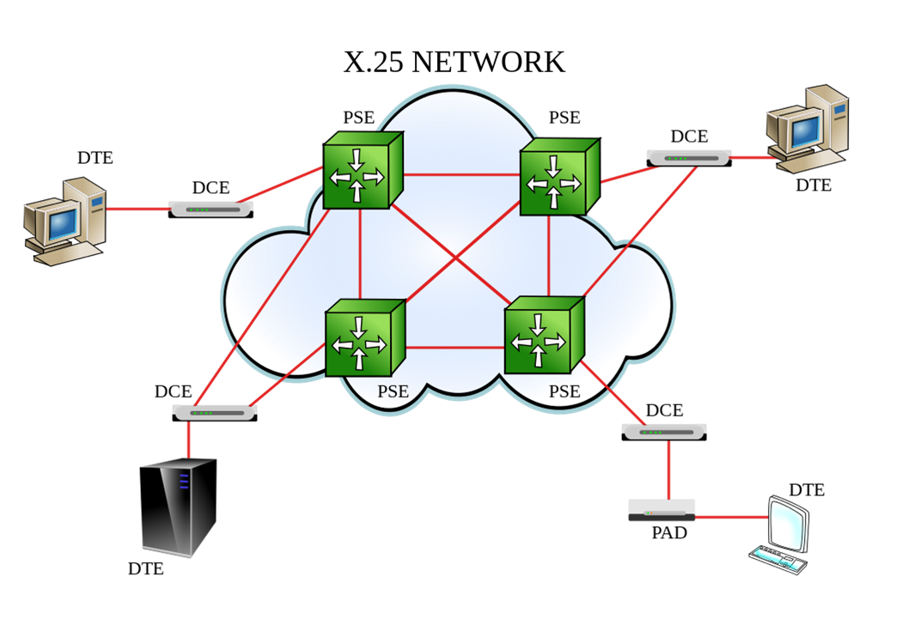
X.25 Protocol
U-frame is used to set up and disconnect the connection between DTE and DCE
I-frames are used to encapsulate PLP packets from the upper layer..
S-frame is used for error control and flow control

Slide 17
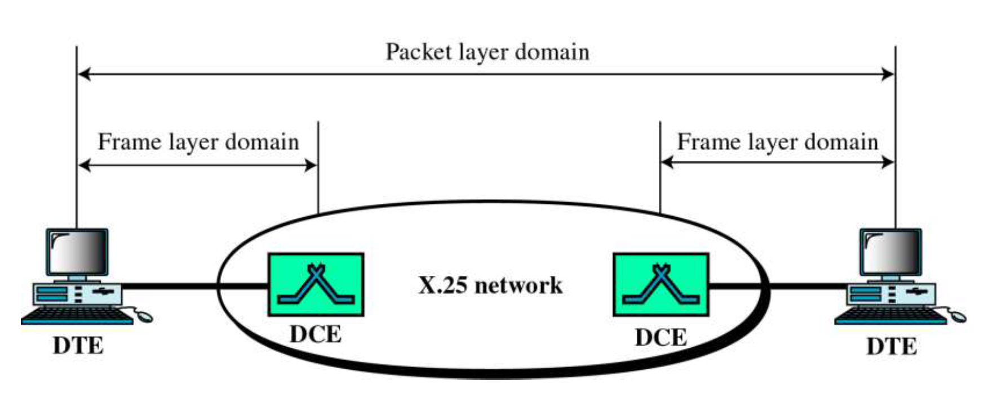
X.25 Protocol

Slide 18
virtual circuits in X.25
Two types of virtual circuit exists in x.25
Switched virtual circuits (SVCs)
Permanent virtual circuit (PVCs)

Slide 19
SVC & PVC
Switched virtual circuits (SVCs) are:
temporary connections used for irregular data transfers.
They require that two DTE devices establish, maintain, and terminate a session each time the devices need to communicate.

Slide 20
SVC & PVC
Permanent virtual circuits (PVCs) are:
permanently established connections used for frequent and consistent data transfers.
PVCs do not require that sessions be established and terminated.
Therefore, DTEs can begin transferring data whenever necessary because the session is always active

Slide 21
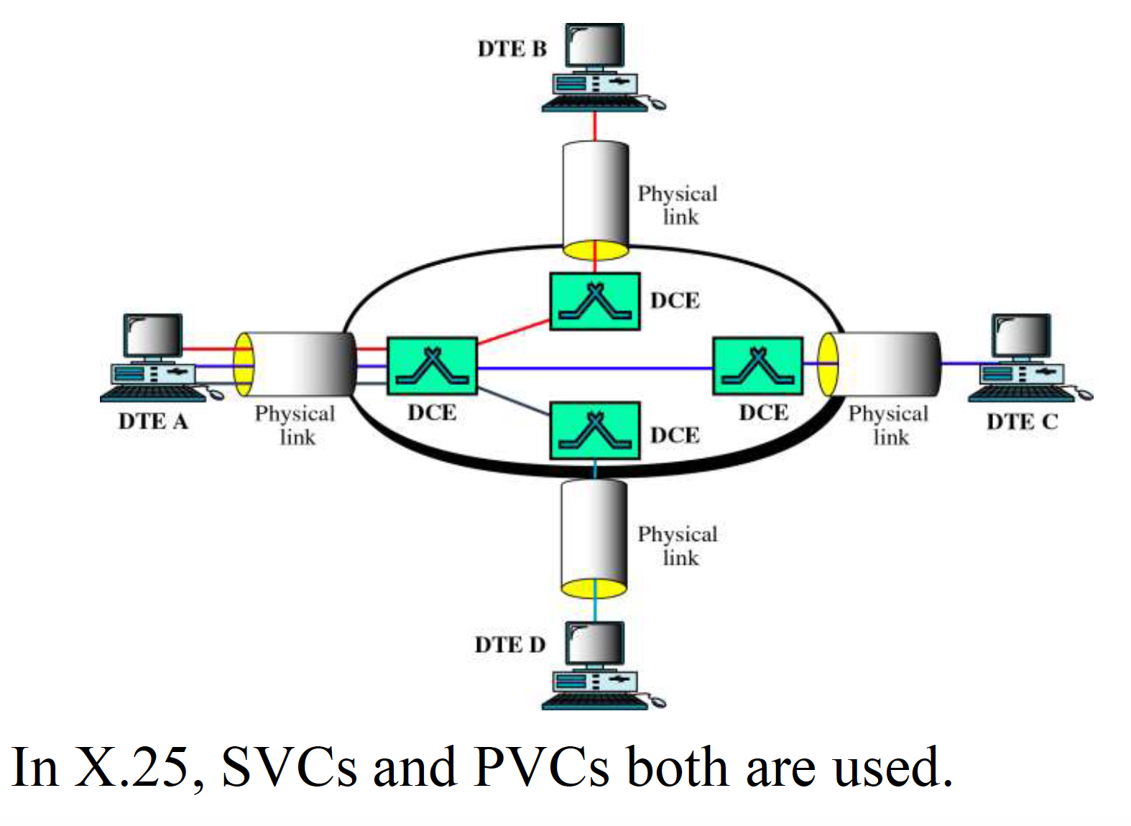

Slide 22
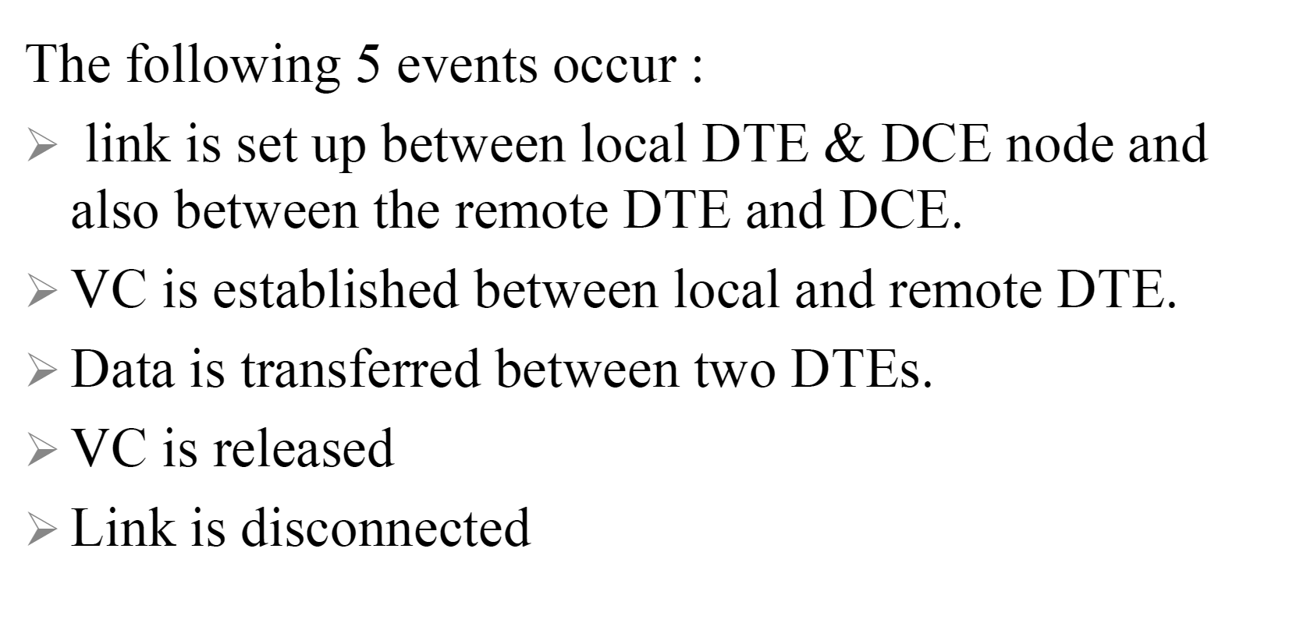
X.25 Protocol

Slide 23
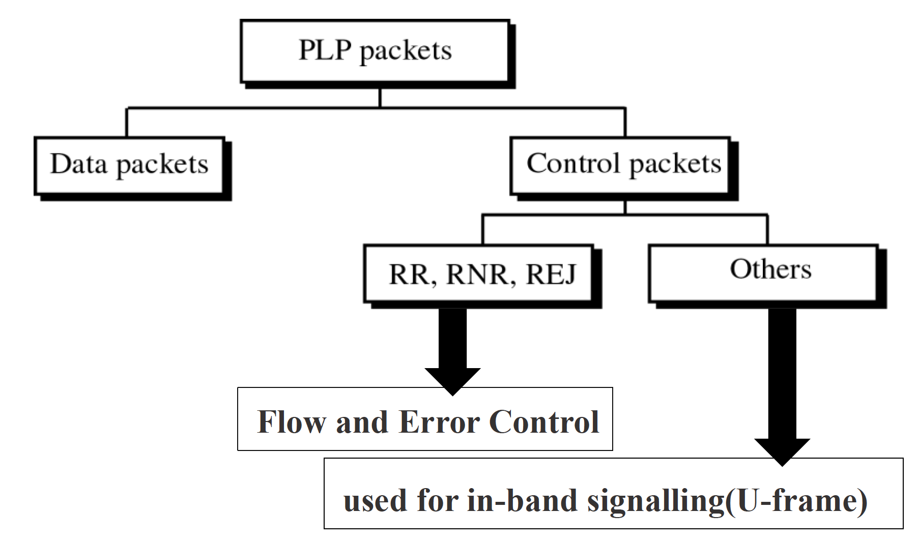
X.25 Protocol

Slide 24
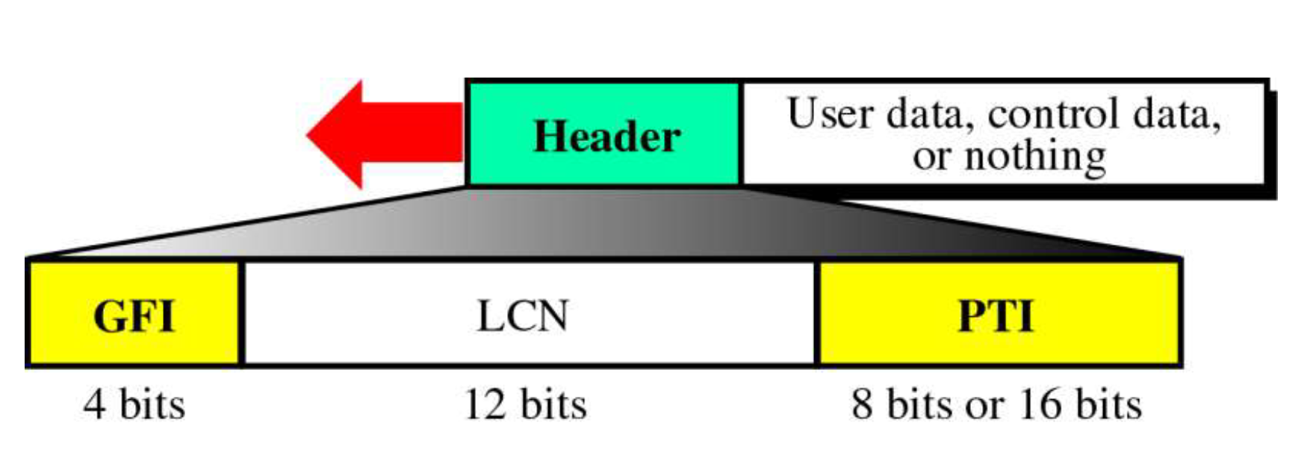
PLP Packet
GFI or General Format Identifier is a 4 bit field.
LCN- Logical Channel Number
PTI or Packet Type Identifier defines the type of packet, viz. data packet or control packet.

Slide 25
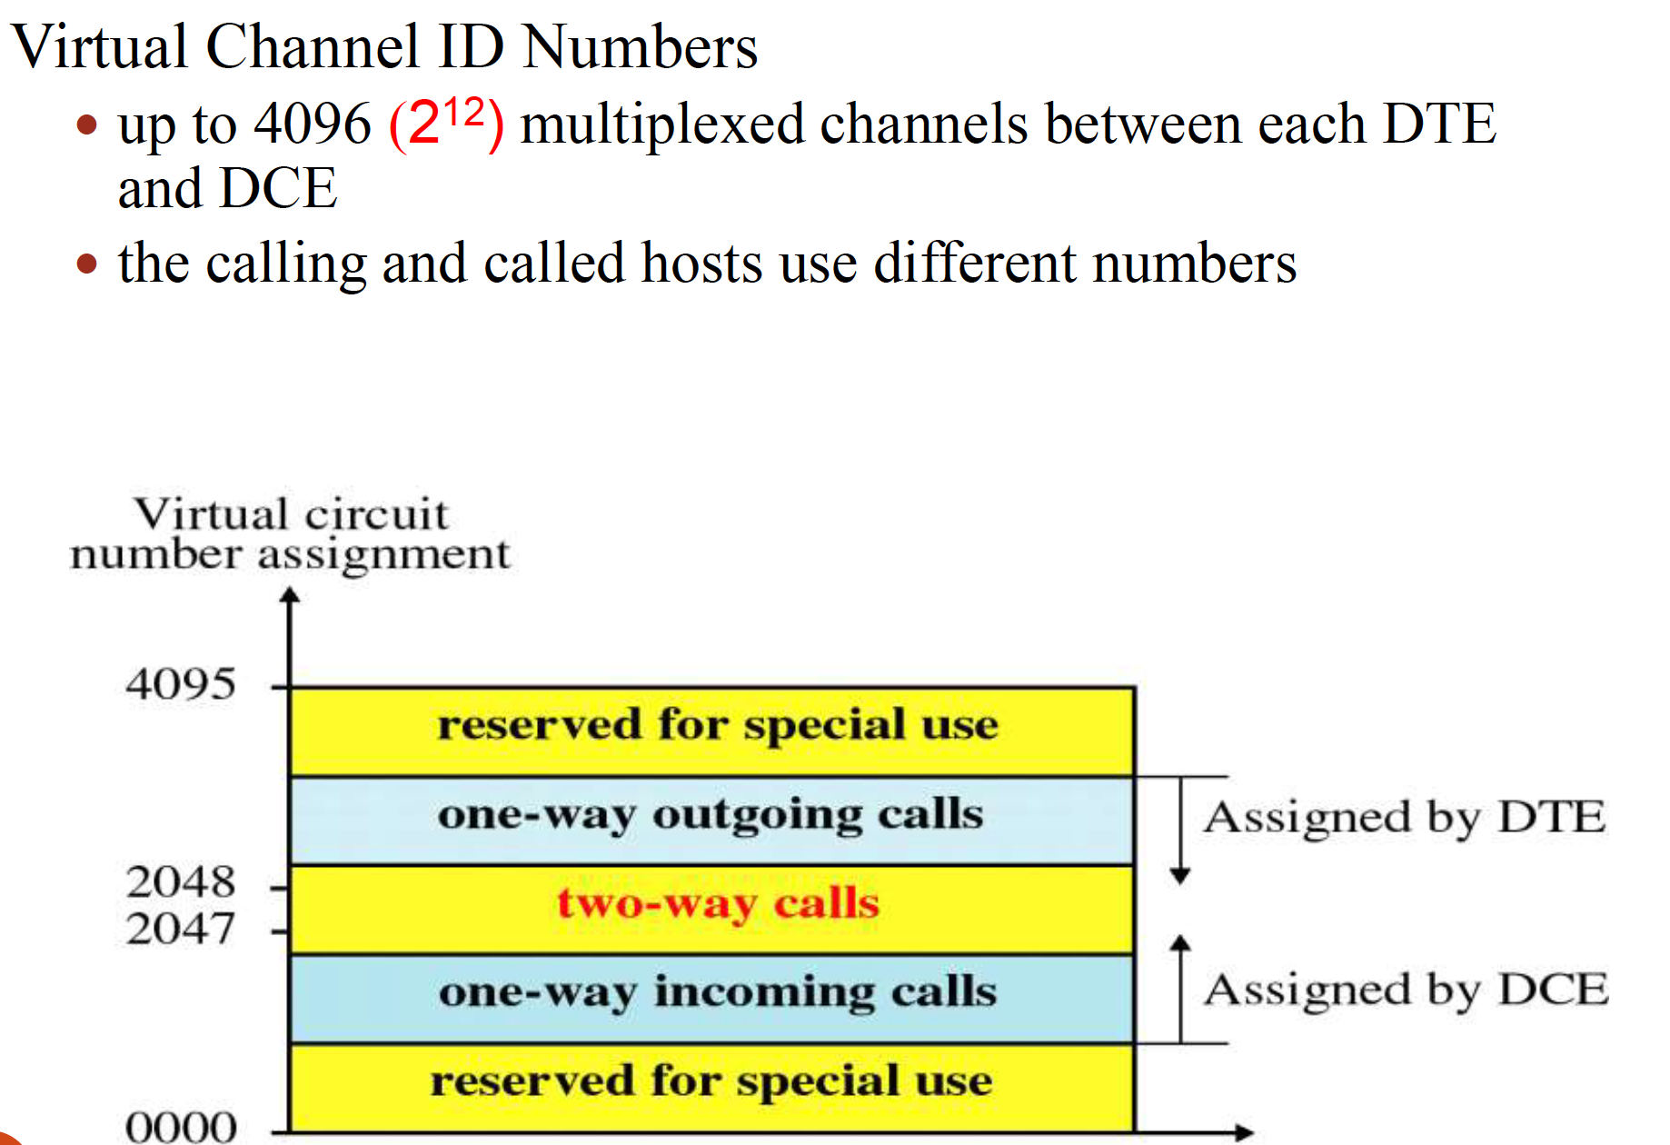
PLP Packet

Slide 26
